Slide 1
Quantum
Computing

Slide 2
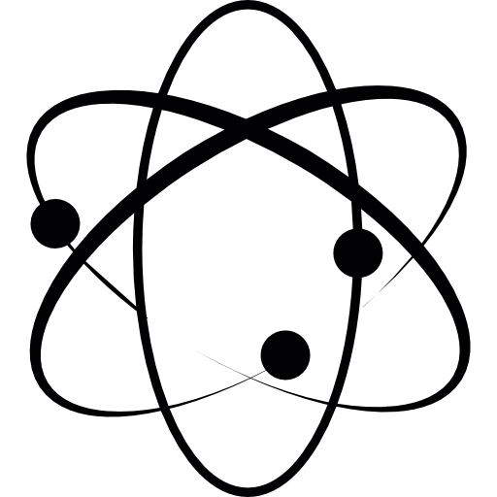
Outline
Quantum Physics
Quantum Computer
Limitations
Applications
Problem Discussion

Slide 3
1.
Quantum Physics
Richard Phillip Feynman :
I can safely said no body understands quantum theory.

Slide 4
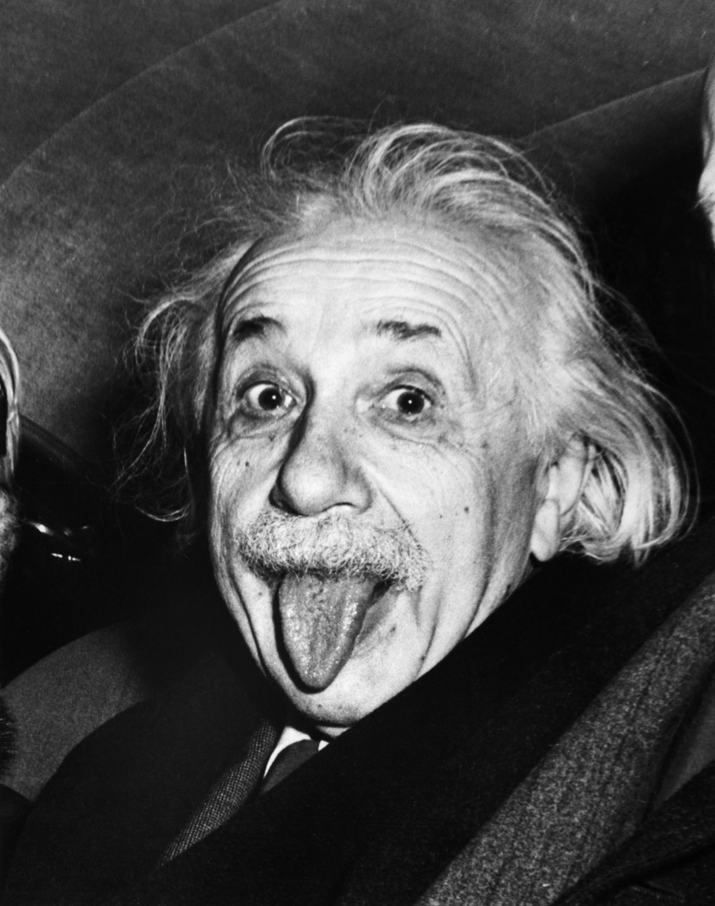
Physics of Microscopic World
It is a description of the way the small particles like electron, atom, molecule
Their behavior is quite different from the behaviour of larger objects
God does not play dice with the universe.
Notes:
宏觀世界 我站在這就在這、微觀世界 機率、我可能在這也可能不在這。幹話，科學家透過幾百年實驗證明了，過往電子快速繞原子核，同時。
愛因斯坦有一句廣為流傳的名言，說上帝不擲骰子。
接受自然界有某些事物是隨機的，他無法接受有些事情就這樣發生、而事後也無法推敲成因。認為宇宙按照機械作用運行，每個時刻都環環相扣。假若一位智者能知道在某一時刻所有促使自然運動的力和所有組構自然的物體的位置，假若他也能夠對這些數據進行分析
量子力學認為，隨機性是內建於物理世界的特徵：放射性的原子核會自發衰變，沒有規則能預測發生的時間或原因。

Slide 5
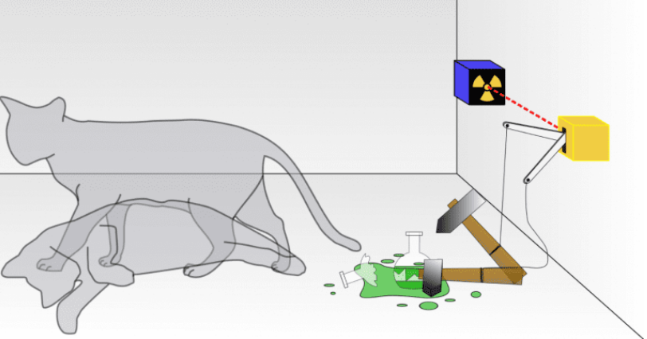
Schrödinger's Cat
Schrödinger's cat is a thought experiment, devised by Austrian physicist Erwin Schrödinger in 1935.

Slide 6
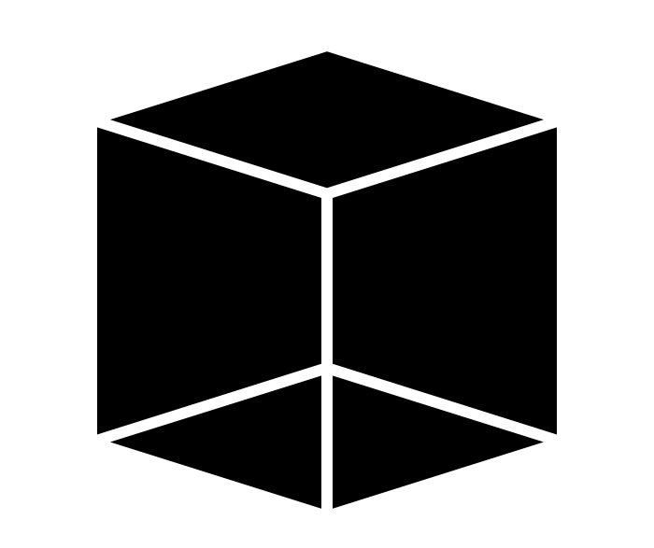

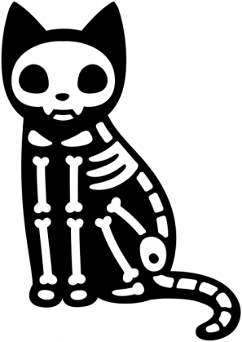
Schrödinger's Cat

Slide 7
Superposition
The ability to simultaneously be in multiple states
The final result emerges only when they are measured, which causes their quantum state to “collapse” to either 1 or 0

Slide 8
Entanglement
Researchers can generate pairs of particles that are “entangled"
The two particles act simultaneously in a predictable way
Notes:
另外一個很牛的現象，量子糾纏。
找來兩個電子放一起成一對，再分開。去監測這兩個電子

Slide 9
2.
Quantum Computer
A quantum computer is a machine that performs calculations based on quantum mechanics
Notes:
量子電腦，是一種使用量子邏輯進行通用計算的裝置。
不同於電子電腦（或稱傳統電腦），量子計算用來存儲資料的對象是量子位元，它使用量子演算法來進行資料操作。

Slide 10
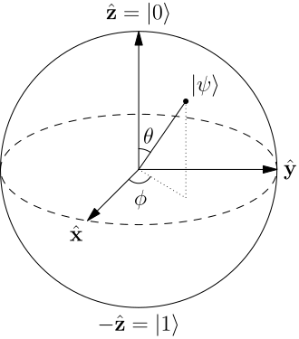
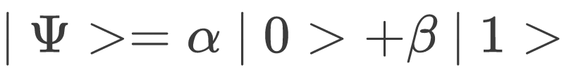
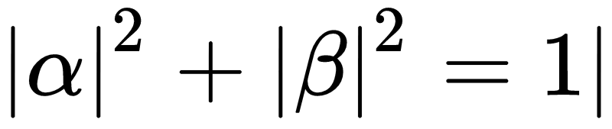
Qubit
Two states exist simultaneously:
|0>
|1>
where
Notes:
量子必須達到量子疊加（quantum superposition）和量子糾纏狀態（quantum entanglement）：即單一量子須同時處於兩種物理狀態，且兩個量子間需形成聯結，使得兩個量子即使不處於同一個空間，卻可以即時互相影響，才能做為量子運算基本單元¹⁷。

Slide 11

Public-key Cryptography
．RSA
- Multiplying two large prime numbers is easy
- Prime factorization of large integer is difficult
Notes:
量子計算：可以把35711等除數同時帶入表達式，看看有沒有餘數
FI 1 = ½ (3 5 7 11) 他們四個是一個疊加態到一個量子狀態之中，同時其中各四個量子比特是糾纏的，這樣才可以實現。
同時1529也可以寫成一個量子態
FI 2
透過一些量子的特點可以做這樣的除法，F2/F1 他就會去找沒有餘數的，當然其中過程很複雜才能實現 我說的比較簡略

Slide 12
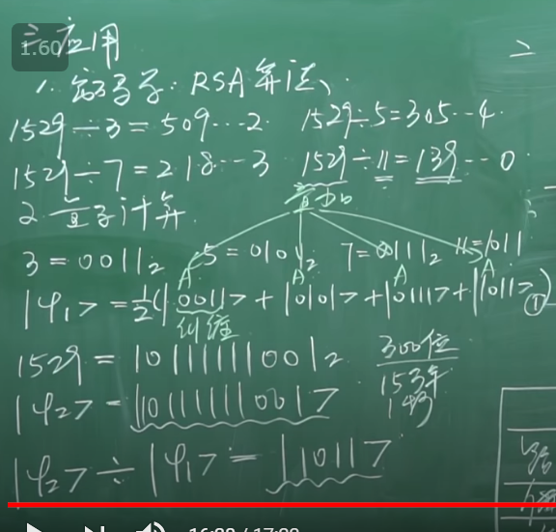

Slide 13
Why Quantum Computers are Powerful?
2
4
8
1,073,741,824
1.267650e+30
A Qubit
2 Qubits
3 Qubits
states
states
states
30 Qubits
states
100 Qubits
states
Notes:
https://www.bnext.com.tw/article/50996/theres-now-proof-that-quantum-computers-can-outperform-classical-machines

Slide 14
Quantum Computer
 | Classical Computer | Quantum Computers
Feature | Large-scale integrated multipurpose computer | High-speed computers based on quantum theory
Information Representation | A bit : either 0 or 1 | A qubit : superposition of 0 and 1
Information Processing | Logical gatas (NOT, AND,OR, ...) | Quantum logical gates (Hardmond, CNOT, ...)
Calculation | Voltage, charge | Altering states of atoms
Noise Tolerance | High | Low
Notes:
計算機通過邏輯電路完成的、是或非各種邏輯門做計算
量子閘是可逆的，notgate可逆 輸入是輸出非；nor不可逆 真真真，無法回推。
計算方式：半導體裡面通電不通電、改變原子的狀態

Slide 15

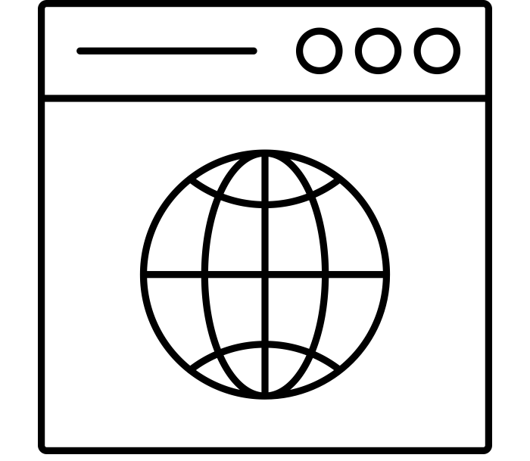

Will Quantum Computers Replace Classical Computers?
NO !
Only Good at Solving specific problems
NP problem
Parallel computing
Complicate system

Slide 16
3.
The Limitations of Quantum Computers

Slide 17

The Difficulties of Quantum Computer
Physical problems and scalability
Computing environment
Accuracy and stability
Software
Notes:
https://www.eettaiwan.com/news/article/20181029NT01-Quantum-Computing-Is-Mathematically-Better

Slide 18
1. Physical Problems and Scalability
Satisfying superposition and entanglement
Very difficult to produce quantum
Superconductor | Semiconductor
Used by IBM, Google | Used by Intel and Qutech
Google made a quantum computer with 72 qubit | Princeton University made a quantum chip by silicon
Notes:
．一個使量子電腦能夠進入實際應用的關鍵，是量子位元的可擴充性。
．製造量子晶片技術最主流的學派是採用「超導體材料」。超導體材料的優點在於，製造出來的量子位元執行速度快，也較容易製作出多個量子位元，實現量子糾纏，因此吸引Google與IBM等科技公司研發。超導體的技術發展還不像對半導體的成熟、壽命較短。
．現行主流量子運算技術之一的矽自旋量子，就是由於可以利用已經十分成熟的半導體技術，具有和現行電腦相容性，而吸引英特爾和其他研究人員投入研發。普林斯頓大學製造出能夠準確控制兩個電子之間量子行為，以矽為材料的元件，且錯誤率極低。但缺點是較難做多個。

Slide 19
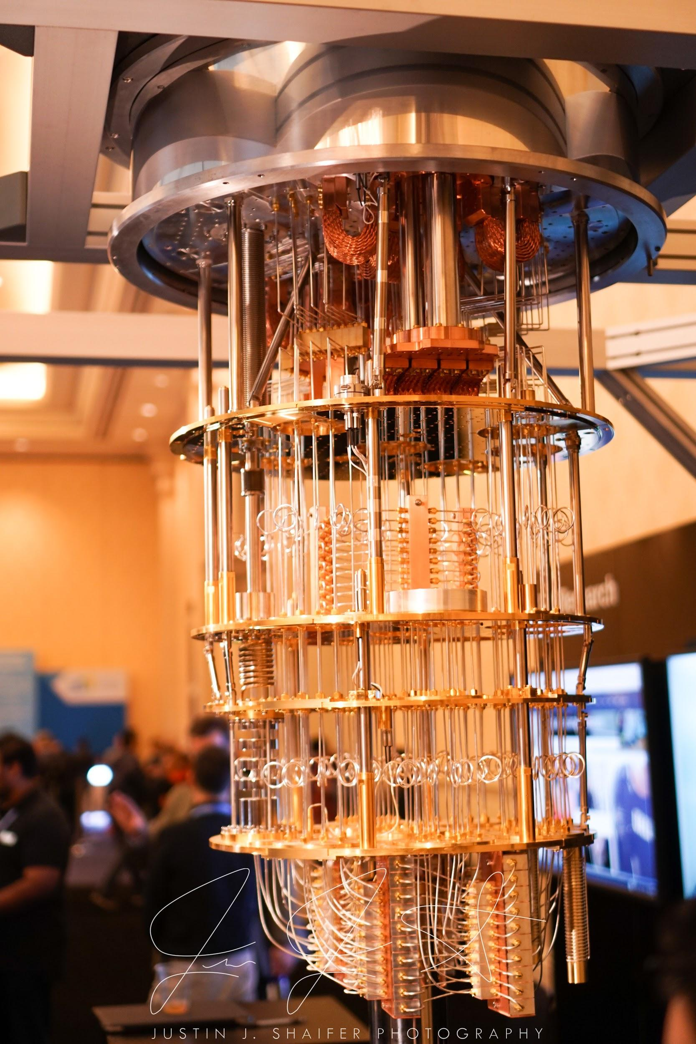
2. Computing Environment
Easy to be affected by thermal energy or radiation.
Environment with
absolute zero is required.
Notes:
量子態十分容易受到振動或電磁場，甚至一般熱擾動的干擾，所以現在的量子電腦需要在接近絕對零度的超低溫度操作
目前主要的技術瓶頸除了增加量子位元數之外，就是如何維持穩定量子態，使量子維持在某個量子態時間夠長，足以完成運算工作並增加運算正確率。

Slide 20
3. Accuracy and Stability
The computation must be finished in 0.001 seconds, or the accuracy will drop when overtime.
Can be improved by algorithms or hardwares.
Use silicon as the material of quantum can reduce the effect of noises.
Notes:
量子很容易受到電磁波、熱輻射等外界干擾，因此技術上還必須讓量子維持在量子糾纏的穩定狀態，完成測量與運算的時間，這稱為相干時間（Coherence Time）
量子狀態需要準備、計算、最後測量，這些運作都需要時間，需要在量子狀態崩潰以前完成，這與量子位元的組成材質息息相關。
量子態越穩定越不容易操作，越容易操作的量子位元越易受週遭環境的干擾。

Slide 21
4. Softwares
The computation of quantum computer and traditional computer are different.
Let the quantum computer knows the problems we think.
Microsoft released “Q#” as a programming language for software development of quantum computer.
Notes:
量子運算程式的複雜度和難度源於量子電腦的本質，運算時將帶有一定程度的雜訊，所以程式設計時必需將量子電腦的物理原理和位元限制納入考量，需要先預建雜訊模擬模型，以處理操作正確性的問題。
新的演算法和開發工具的需求，量子電腦軟體設計人員需具備深厚的物理、數學和軟體工程知識，跨領域、對各領域有深度知識的人

Slide 22
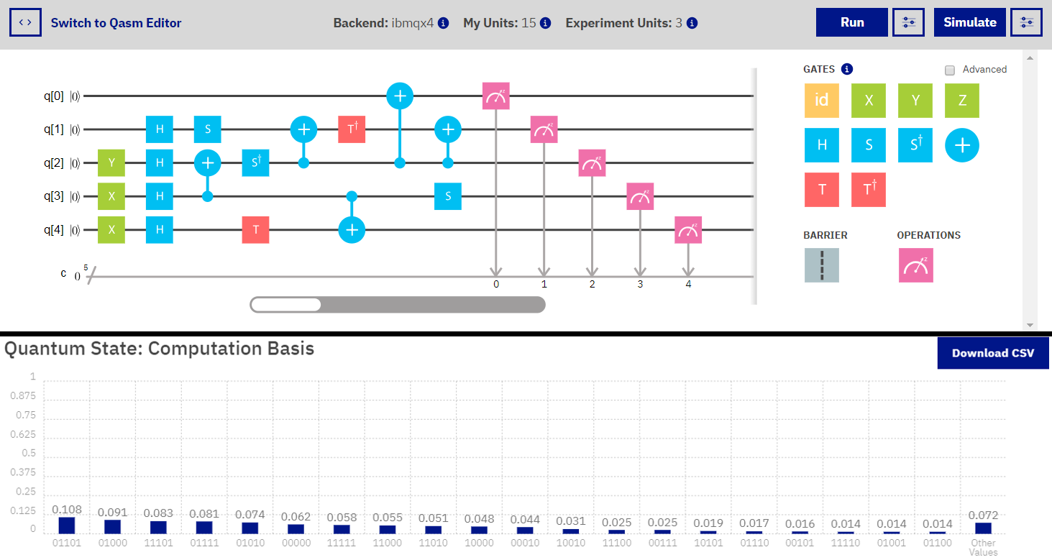
How it works ? - IBMQ

Slide 23
4.
Applications

Slide 24
Quantum Cryptanalysis - Shor’s Algo
Factoring(質因數分解)、DLP(離散對數)、ECDLP(橢圓曲線)...Computational difficult problem
Convert the above question to Order-Finding Question
and use Quantum Fourier Transform(量子傅利葉轉換) to solve in polynomial time.
O(n³logn)
IBM - Decompose 15 into 3 × 5 using 7 qubits

Slide 25
Quantum Cryptanalysis - Shor’s Algo
Traditional computer break private key in
109,200,000,000 years
100 qubits crack in 3 hours
4099 qubits crack in 3.59 seconds

Slide 26
Artificial Intelligence
Parallel computing
-matrix multiplication in Neural network
Find the optimum solution
-AlphaGo's has a part that evaluates the value of each move - is the maximum value of this evaluation to find the optimum solution
Trapped in local optimum solution
-Traditional computer machine learning
Notes:
https://www.digitimes.com.tw/col/article.asp?id=575
https://www.bnext.com.tw/article/47890/quantum-qubit-quantum-manifesto

Slide 27
Parallel Computing
The world produces about 1 billion GB of data per day
= 250,000 US Congress Library
= 5,000,000 notebook’s data
There are 3.2 billion Internet users
- Publish nearly 350,000 twitters per minute
- Press 4,200,000 likes on Facebook per minute
Real Parallel computing（superposition,entanglement）
-Traditional computer（multi CPU）
-64 Qubits(One operation can simultaneously process
18,446,744,073,709,551,616 nums)
-545 trillion times faster than supercomputer(天河2號)
Notes:
https://www.gvm.com.tw/article.html?id=41082
http://stevchen.pixnet.net/blog/post/66822384-%E9%87%8F%E5%AD%90%E9%9B%BB%E8%85%A6%E7%9A%84%E9%81%8B%E7%AE%97%E9%80%9F%E5%BA%A6-%E6%98%AF%E5%82%B3%E7%B5%B1%E9%9B%BB%E8%85%A6%E9%81%8B%E7%AE%97%E9%80%9F%E5%BA%A6%E7%9A%8454

Slide 28
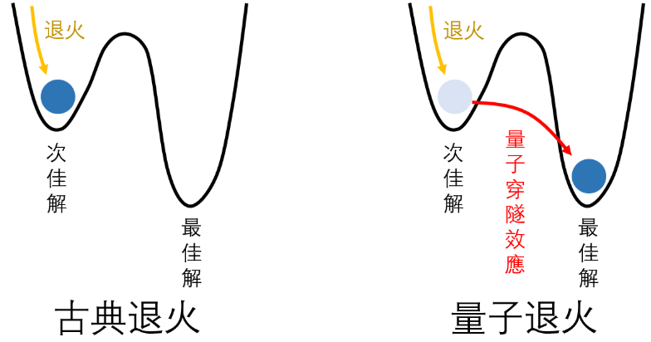
Find the Optimum-Simulated Annealing
Notes:
https://case.ntu.edu.tw/blog/?p=31052

Slide 29
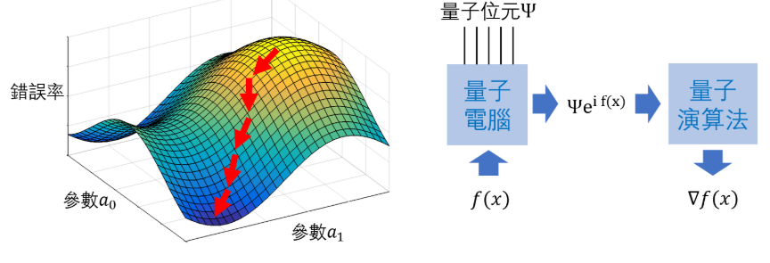
Find the Optimum-Gradient Descent
傳統梯度下降法
量子演算法計算梯度概念
Notes:
https://case.ntu.edu.tw/blog/?p=31052

Slide 30
Other Applications
Biological Pharmaceutical (Protein folding)
Chemical Engineering
Searching in Unsorted Database
Quantum Network

Slide 31
Forecast of Future Development
When will a(large-scale) quantum computer be built?
—“There is a 1 in 7 chance that some fundamental public-key crypto will be broken by quantum by 2026, and a 1 in 2 chance of the same by 2031.”
Notes:
http://sa.ylib.com/MagArticle.aspx?Unit=featurearticles&id=2877

Slide 32
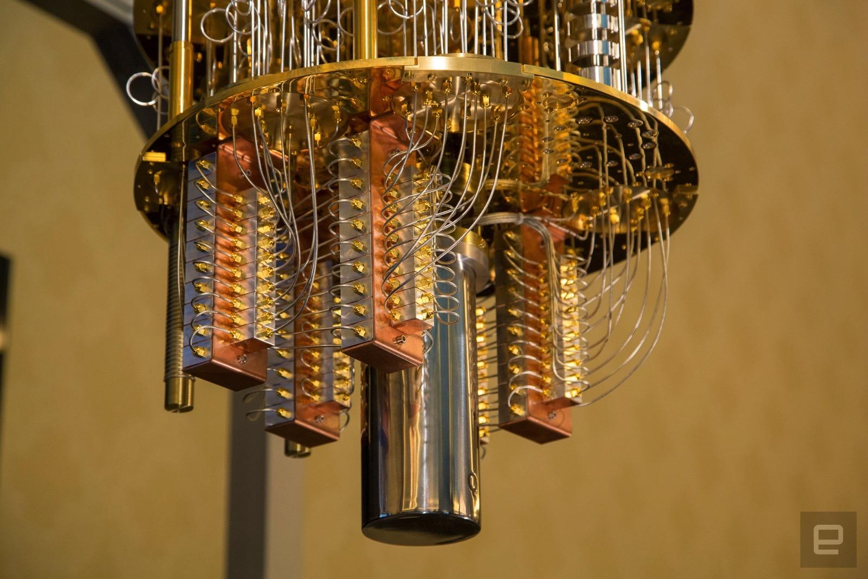
Thank you!
Notes:
https://pansci.asia/archives/137552
https://pansci.asia/archives/140036
https://zhuanlan.zhihu.com/p/60990814
https://www.gvm.com.tw/article/41082
https://stevchen.pixnet.net/blog/post/66822384-%E9%87%8F%E5%AD%90%E9%9B%BB%E8%85%A6%E7%9A%84%E9%81%8B%E7%AE%97%E9%80%9F%E5%BA%A6-%E6%98%AF%E5%82%B3%E7%B5%B1%E9%9B%BB%E8%85%A6%E9%81%8B%E7%AE%97%E9%80%9F%E5%BA%A6%E7%9A%8454

